Slide 1




WB4
Consider this linear programming problem:
Maximise
Subject to:
This cannot be represented by a graph as there are 3 variables
In D2 we solve problems like this using the Simplex Algorithm, created in 1947.
It has become an invaluable, contemporary tool in microeconomics, company management and operational research, all of which are concerned with making decisions about how to allocate limited resources.

Slide 2




















As inequalities
As equations
Variables not equal to zero are listed in the Basic Variable column, with their necessary initial value in the last column
Each equation is recorded as a line, with the coefficients of each variable written in the appropriate column
‘Slack variables’ are introduced to turn the inequalities into equations
Eg if x=0, y=0, z=0 then r=3600 to satisfy the first equation
This information is then recorded in a ‘Simplex Tableau’
Any variables not in this column are zero, initially
b.v. | x | y | z | r | s | t | Value

Slide 3





Maximise
Rearranging this in a similar way to the other equations
This is consistent because if x=0, y=0 and z=0 (as they are not listed Basic Variables) then P=0
b.v. | x | y | z | r | s | t | Value
This tableau is the starting point for the algorithm which effectively tests each ‘vertex’ of the feasibility ‘region’

Slide 4

The simplex algorithm
Identify smallest value in objective row (bottom) to obtain pivot column
Calculate θ = ‘value’ ‘pivot column’ for each row (except bottom row)
Identify smallest non-negative θ to obtain pivot (the number in the pivot column)
Divide row identified by pivot to obtain pivot row, shown in new table
Change basic variable in this row to the heading of the pivot column
Eliminate this variable from all other rows using row operations, showing results in new table
If all values in the objective row are non-negative, an optimal solution has been found. If not, repeat steps above.

Slide 5



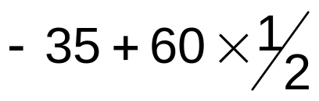
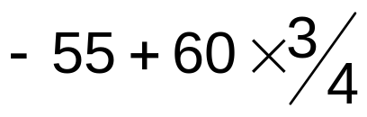
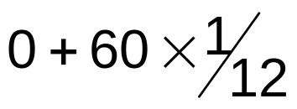
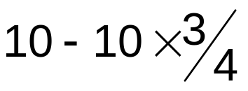
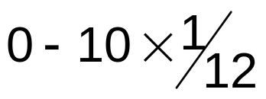
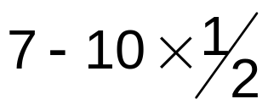
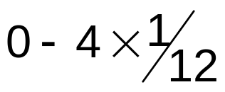
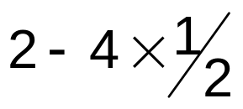
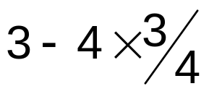


















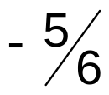





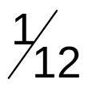

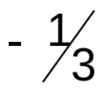








b.v. | x | y | z | r | s | t | Value | θ
r
s
t
P
Identify row containing smallest non-negative θ to obtain pivot (the number in the pivot column)
Eliminate this variable from all other rows using row operations, showing results in new table
If all values in the objective row are non-negative, an optimal solution has been found. If not, repeat the algorithm until you do
Identify smallest value in objective row (bottom) to obtain pivot column
Calculate θ = ‘value’ ‘pivot column’ for each row (except bottom row)
Divide row identified by pivot to obtain pivot row, shown in new table
Change basic variable in this row to the heading of the pivot column
b.v. | x | y | z | r | s | t | Value | Row op
P

Slide 6

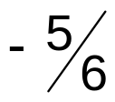



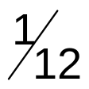

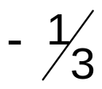




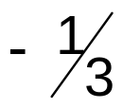
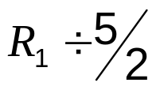

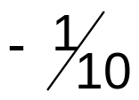

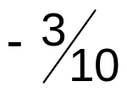


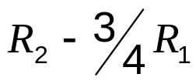





b.v. | x | y | z | r | s | t | Value | θ
r
z
t
P
All values in the objective row are non-negative, so an optimal solution has been found.
b.v. | x | y | z | r | s | t | Value | Row op
P

Slide 7








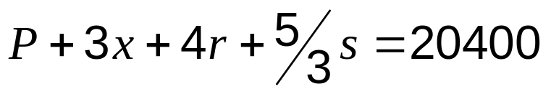
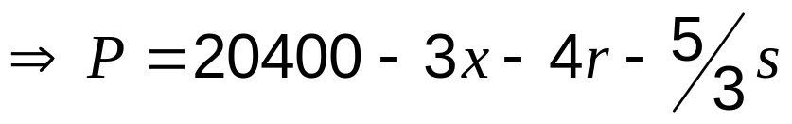
b.v. | x | y | z | r | s | t | Value | Row op
P
Each Basic Variable is given in the ‘Value’ column, unless they are zero
The bottom row can also be returned to an equation to understand why non-negative values indicate an optimal solution
The solution must be optimal, as it is clear from this equation that increasing either x, r or s will decrease P

Slide 8







WB3 The tableau below is the initial tableau for a maximising linear programming problem.
Basic variable | x | y | z | r | s | Value
r | 2 | 3 | 4 | 1 | 0 | 8
s | 3 | 3 | 1 | 0 | 1 | 10
P | -8 | -9 | -5 | 0 | 0 | 0
For this problem , ,
Write down the other two inequalities and the objective function.

Slide 9







































b) Solve this linear programming problem
b.v. | x | y | z | r | s | Value | θ
r
s
P
b.v. | x | y | z | r | s | Value | Row op
P
b.v. | x | y | z | r | s | Value | Row op
P

Slide 10




WB5 A company makes three sizes of lamps, small, medium and large.
The company is trying to determine how many of each size to make in a day, in order to maximise its profit.
As part of the process the lamps need to be sanded, painted, dried and polished.
A single machine carries out these tasks and is available 24 hours per day.
A small lamp requires one hour on this machine, a medium lamp 2 hours and a large lamp 4 hours.
Let x = number of small lamps made per day,
y = number of medium lamps made per day,
z = number of large lamps made per day,
where x ≥ 0, y ≥ 0 and z ≥ 0.
(a) Write the information about this machine as a constraint.
(b)(i) Re-write your constraint from part (a) using a slack variable s.
(ii) Explain what s means in practical terms.
The amount of time each day for which the machine is not in use
Another constraint and the objective function give the following Simplex tableau.
The profit P is stated in euros.
Basic variable | x | y | z | r | s | Value
r | 3 | 5 | 6 | 1 | 0 | 50
s | 1 | 2 | 4 | 0 | 1 | 24
P | –1 | –3 | –4 | 0 | 0 | 0
(c) Write down the profit on each small lamp.
1 euro profit

Slide 11





































b) Solve this linear programming problem
b.v. | x | y | z | r | s | Value | θ
r
s
P
b.v. | x | y | z | r | s | Value | Row op
P
b.v. | x | y | z | r | s | Value | Row op
P

Slide 12









b.v. | x | y | z | r | s | Value | Row op
P
(e) Explain why the solution to part (d) is not practical.
You can’t make 2½ (large) lamps
(f) Find a practical solution which gives a profit of 30 euros. Verify that it is feasible.
1 small, 7 medium and 2 large
Must satisfy

